Slide 1
CS-593 Final Project
IMDB Movie Rating Prediction

Slide 2




10411755 - Vivek
10411830 - Bipin
10415613 - Advait
10416500 - Vicky

Slide 3
IMDB Movie Rating Prediction
Introduction
Overview
Models
Results and Conclusion
Data set : 2016

Slide 4
Introduction
Problem Statement : IMDB Movie rating predictions before release of movie.
How can we predict if movie is good or bad before its release in theatre.
Critics reviews or TV shows which rate movies are not that reliable.
Everyone wants to watch good movie from the pool of movies releasing every year.
To figure out best solution possible for this, we try to predict movie ratings based on models that we build.

Slide 5
Why and How?
Knowing rating of a movie before its release is good option for movie lovers.
Makers of movie will have to put effort in doing good movies as they cant just relay on first week collection.
We will be using different factors such as Actor,Director Facebook likes, Critic Reviews, Budget and Gross money spent on movie, IMDB Score.
https://www.kaggle.com/deepmatrix/imdb-5000-movie-dataset
As per the analysis report made on the data set we found that there were:
28 columns and 5043 rows
Target Variable : IMDB_score

Slide 6
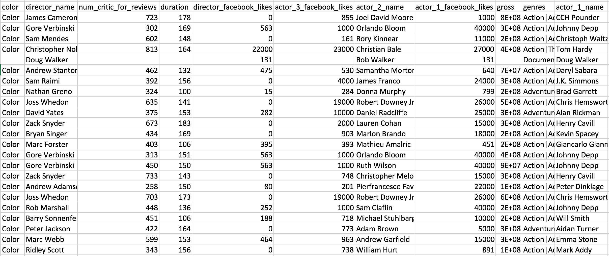
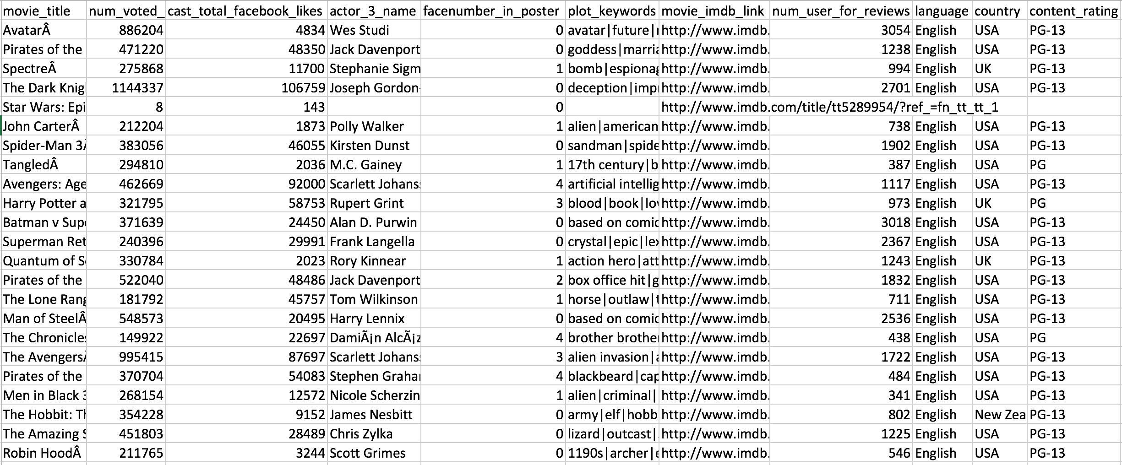
Data set

Slide 7
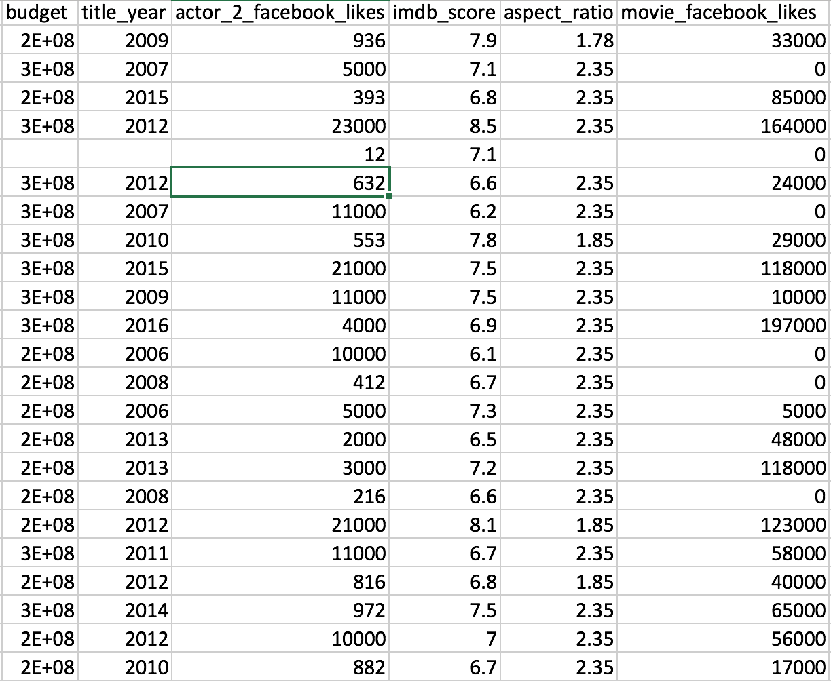
Data set

Slide 8
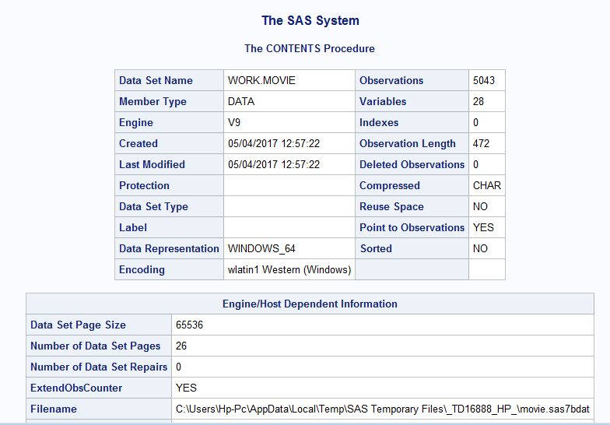
Data set
Initial Dataset:
Used proc import to convert our initial csv dataset into SAS dataset format.

Slide 9
Cleaning data
Deleted the rows – With NA & Missing Values.
Made a new dataset by dropping columns with DROP command.
Renamed variables names in order to make it effective.
Modified the predictors and Target variable to categorical values:
For example: ratings less than 6.6 equal to 1, ratings greater than equal to 6.6 to 0.

Slide 10
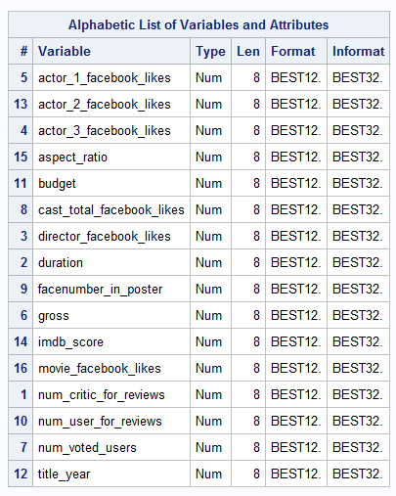
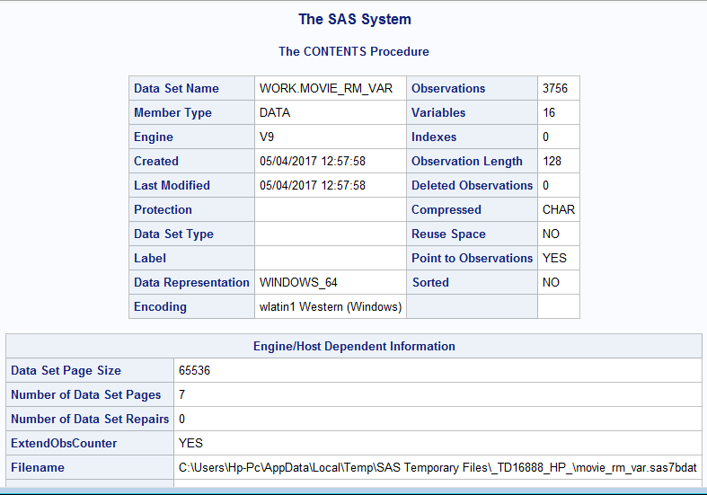
Data set
Cleaning:
After removing the NA values and unwanted variable, the following dataset was created.

Slide 11
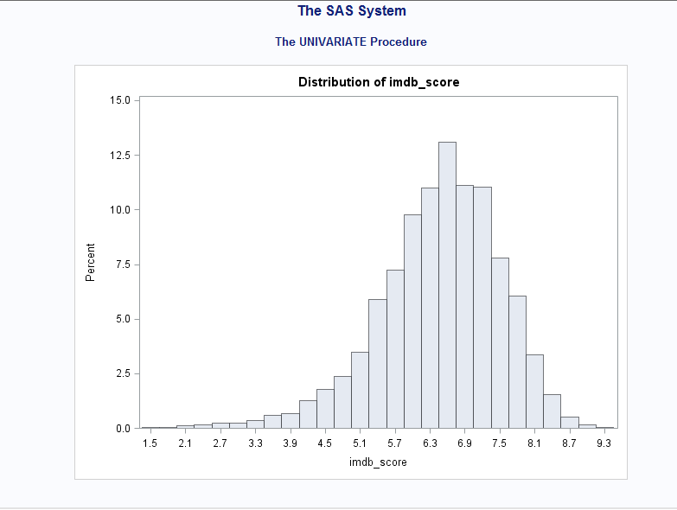
Histogram Plot using PROC Univariate

Slide 12
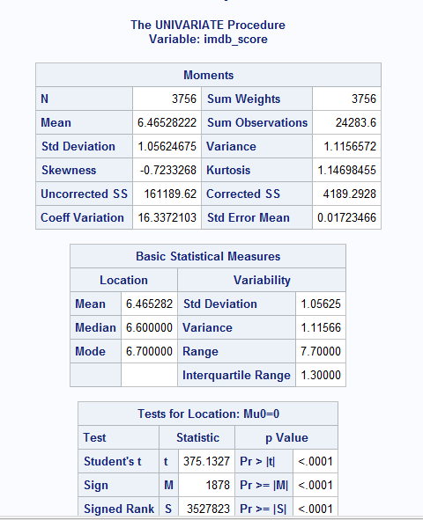
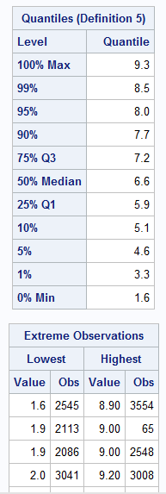
PROC Univariate for IMDB Score

Slide 13
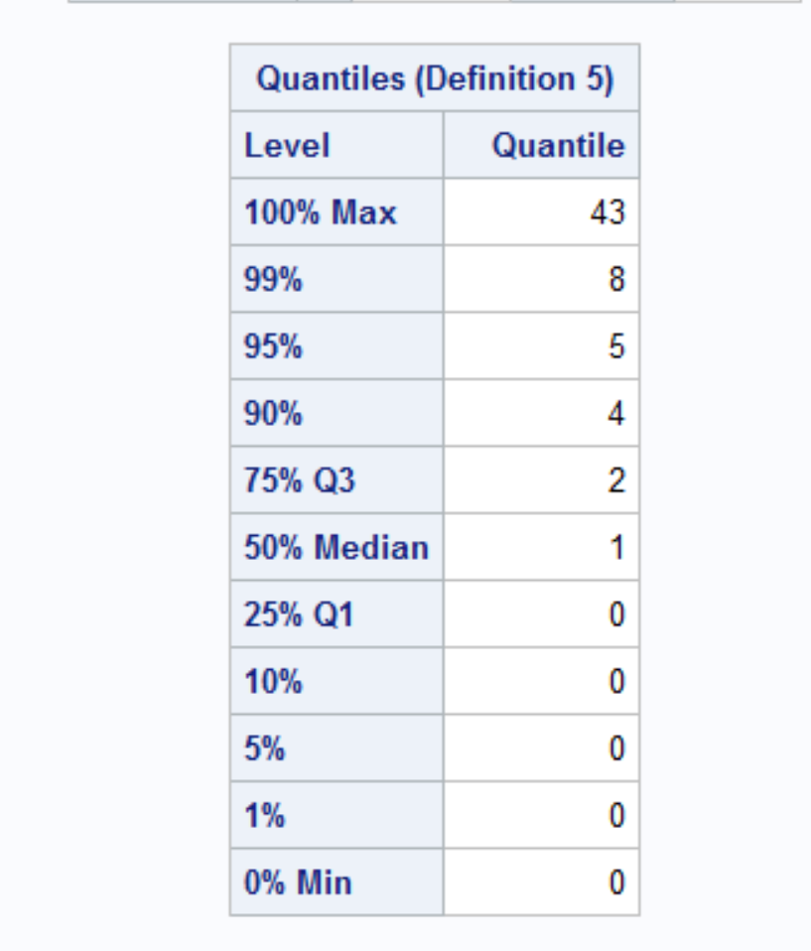
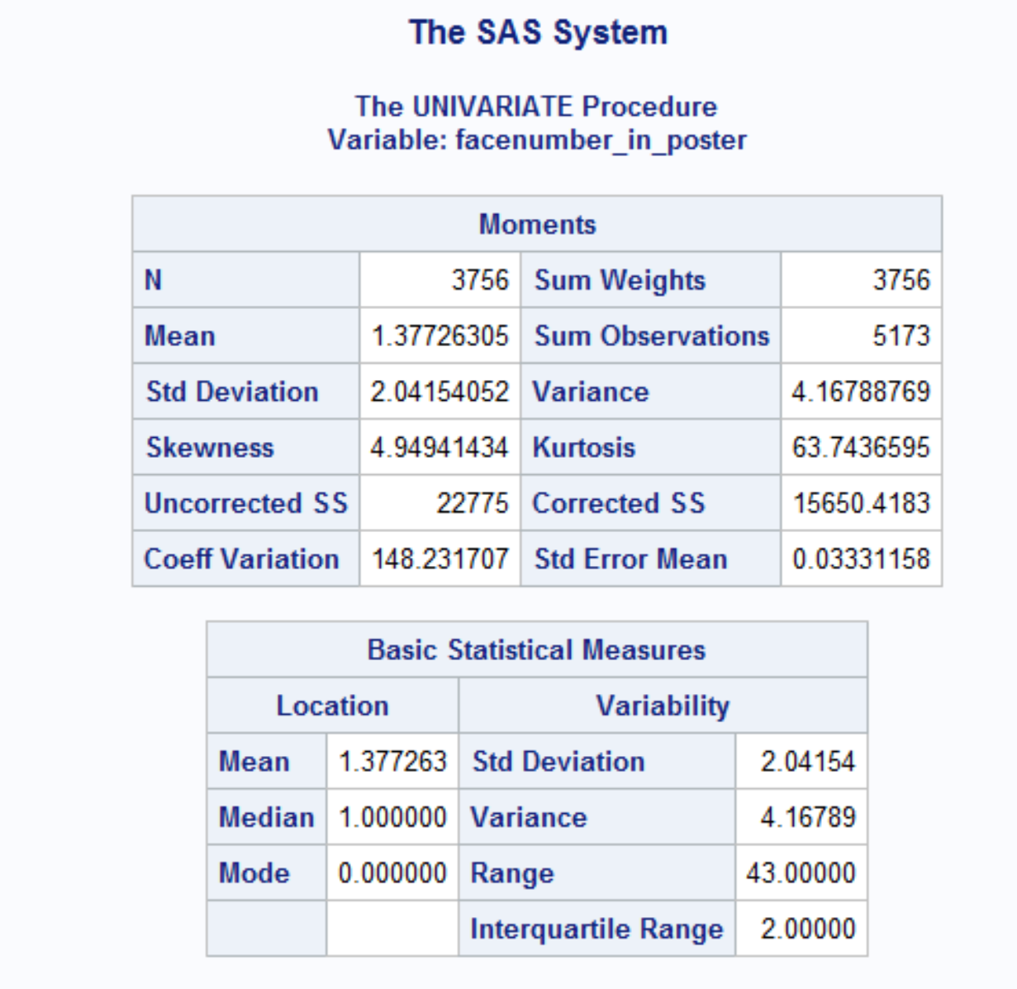
PROC Univariate for Poster Variable

Slide 14
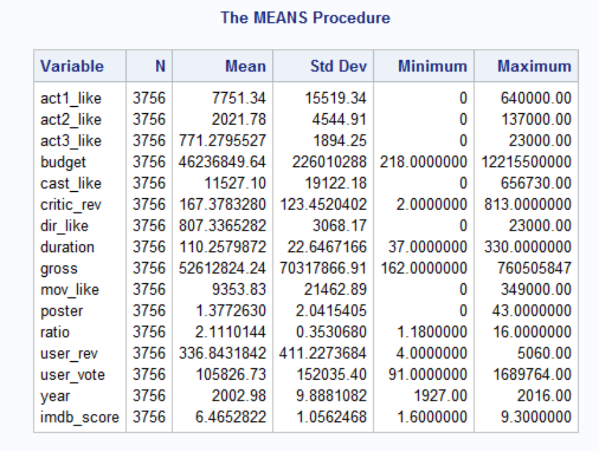
Applying Means

Slide 15
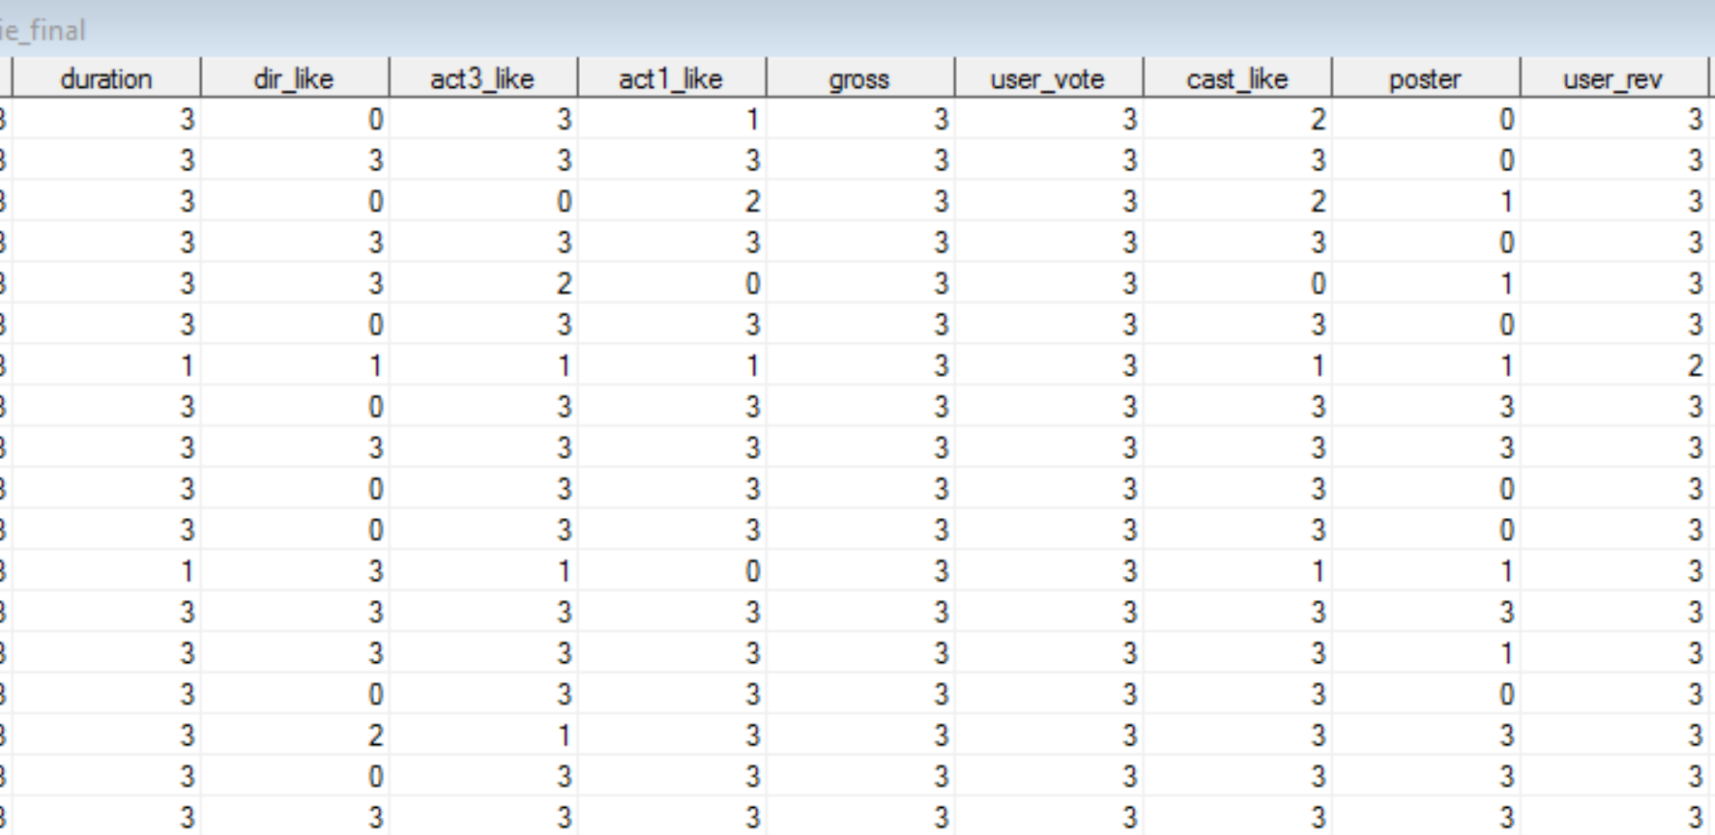
Data after the cleaning and bucketizing

Slide 16
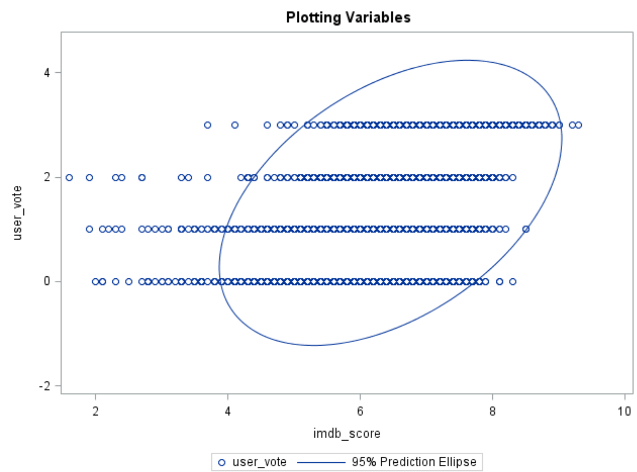
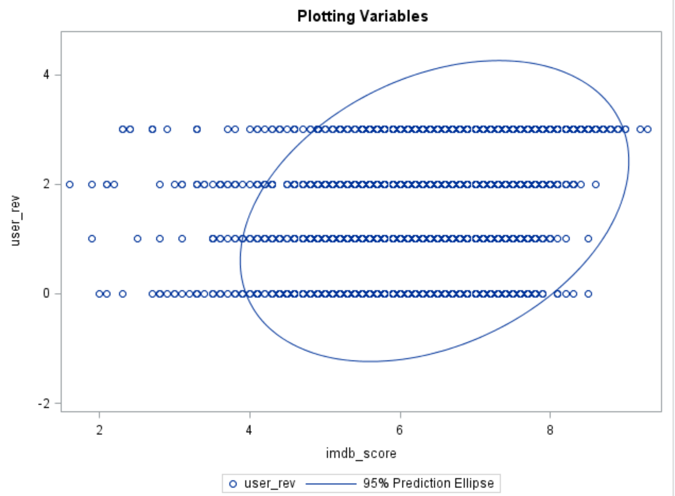
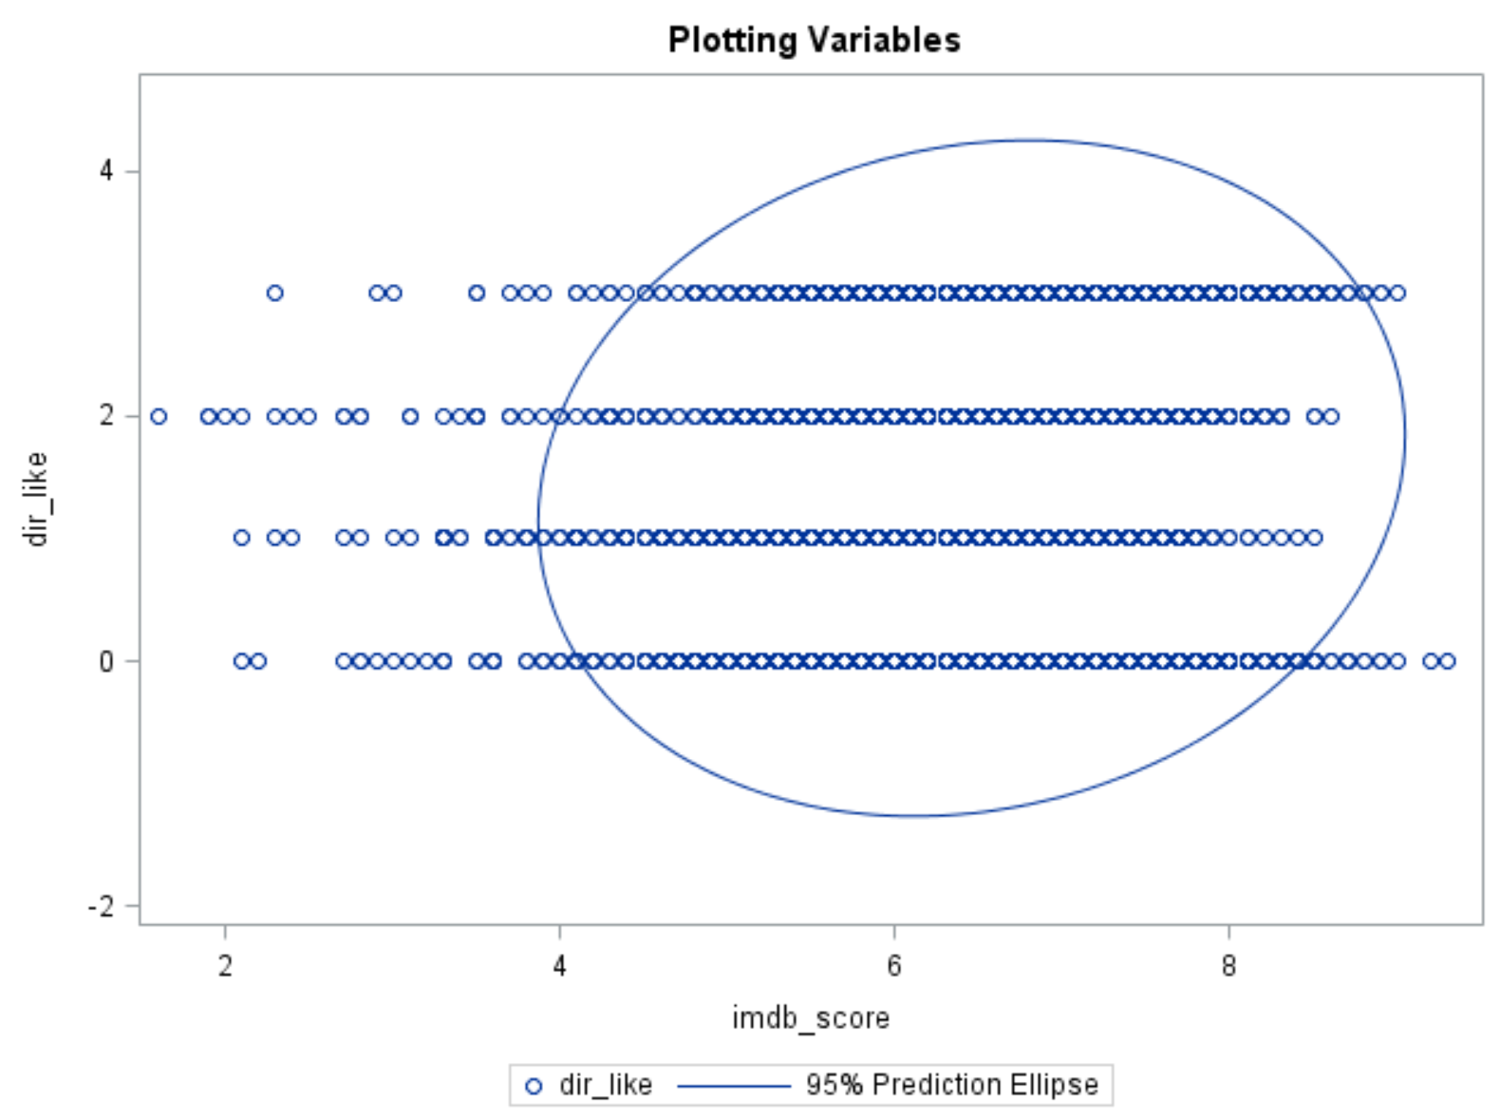
Scatter Plots

Slide 17
Logistic Regression
Used to explain the effects of explanatory variables on binary response.
Converted the Target variable to categorical values of 0’s and 1’s.
Converted the Predictor variables into 4 levels 0, 1 , 2, and 3 based to quartiles.
Class variables used such as “act1_like” “act2_like” “act3_like” “budget” “cast_like” “critic_rev” “dir_like” “duration” “gross” “mov_like” “poster” “ratio” “user_rev” “user_vote” “year”
Used ref=0 for class variables so that 0 is taken as a reference point.
Once logistic regression is run we find the significant variables.

Slide 18
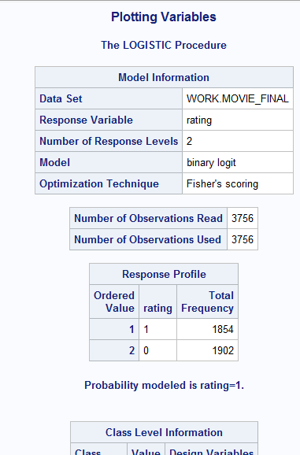
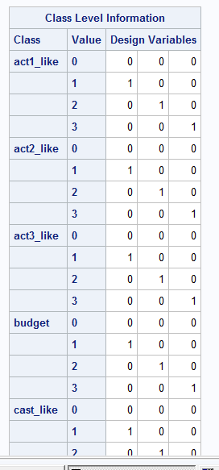
Logistic Regression

Slide 19
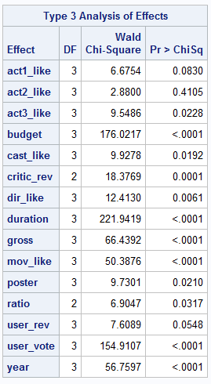
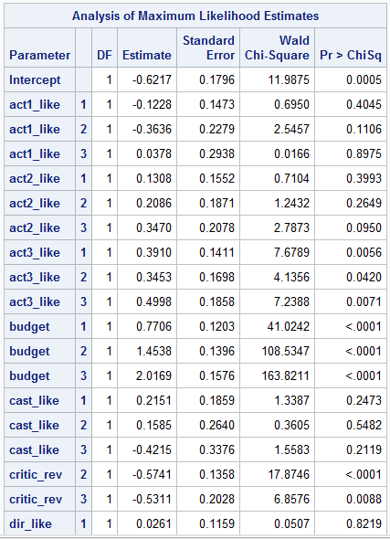
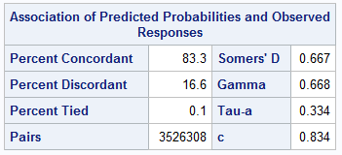
Logistic Regression

Slide 20
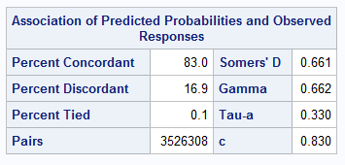
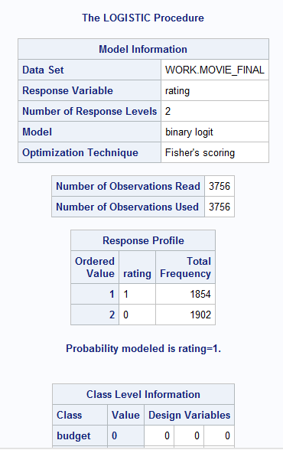
Logistic Regression
Based on our logistic regression, we found out c value to be 83.4% which is good for our target variable using our predictors.
After removing insignificant variables having value less than 0.05 or 5%.
The removed variables are “act1_like” “act2_like” “act3_like”.
After running logistic regression again, we get c value to be

Slide 21
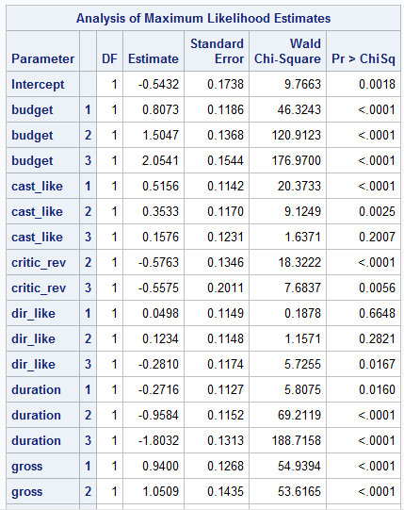
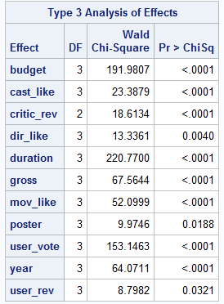
Logistic Regression

Slide 22
Correlation
After running Logistic regression, we wanted to check for correlation between different predictor variables.
So we ran Proc CORR to check correlation and found some of the correlation between the variables.

Slide 23
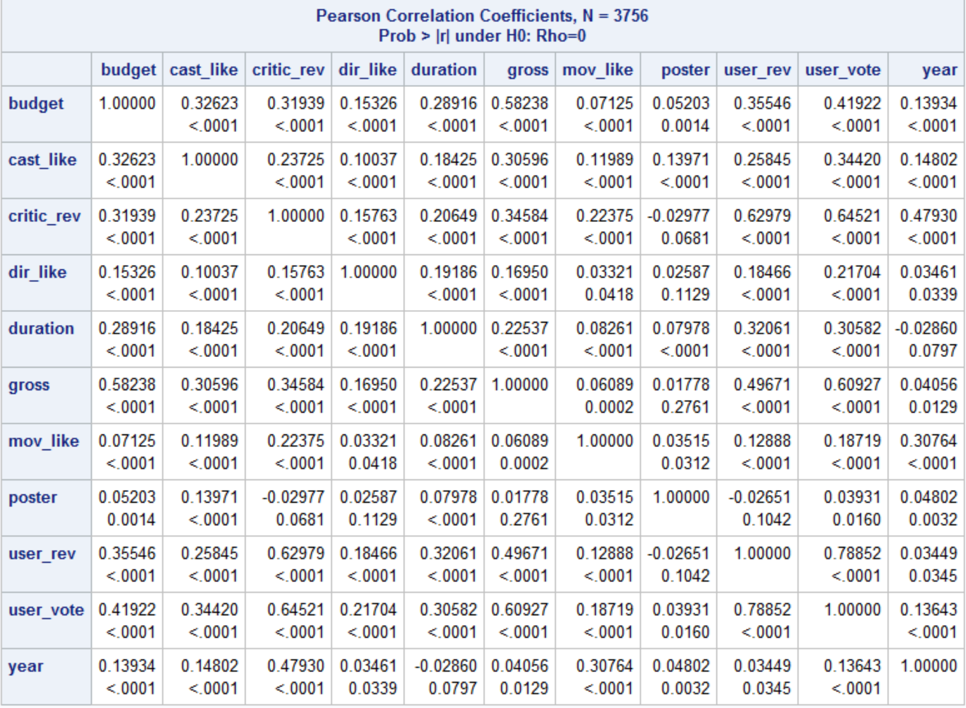
Correlation

Slide 24
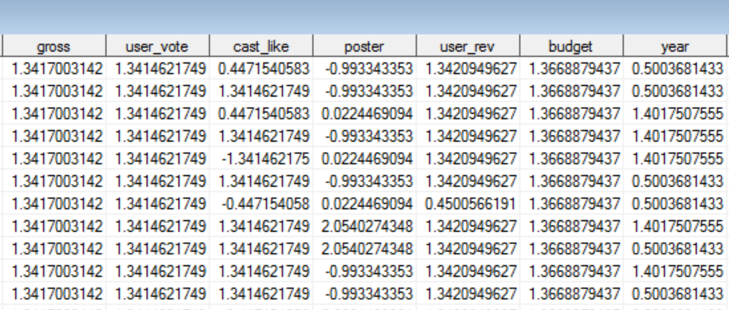
PCA
In order to remove the Correlation and do reduce the number of variables, Applied the PCA technique.
Normalized the Data (USING PROC STANDARD)
Applied PCA for the Variables excluding the Target variable (rating)

Slide 25
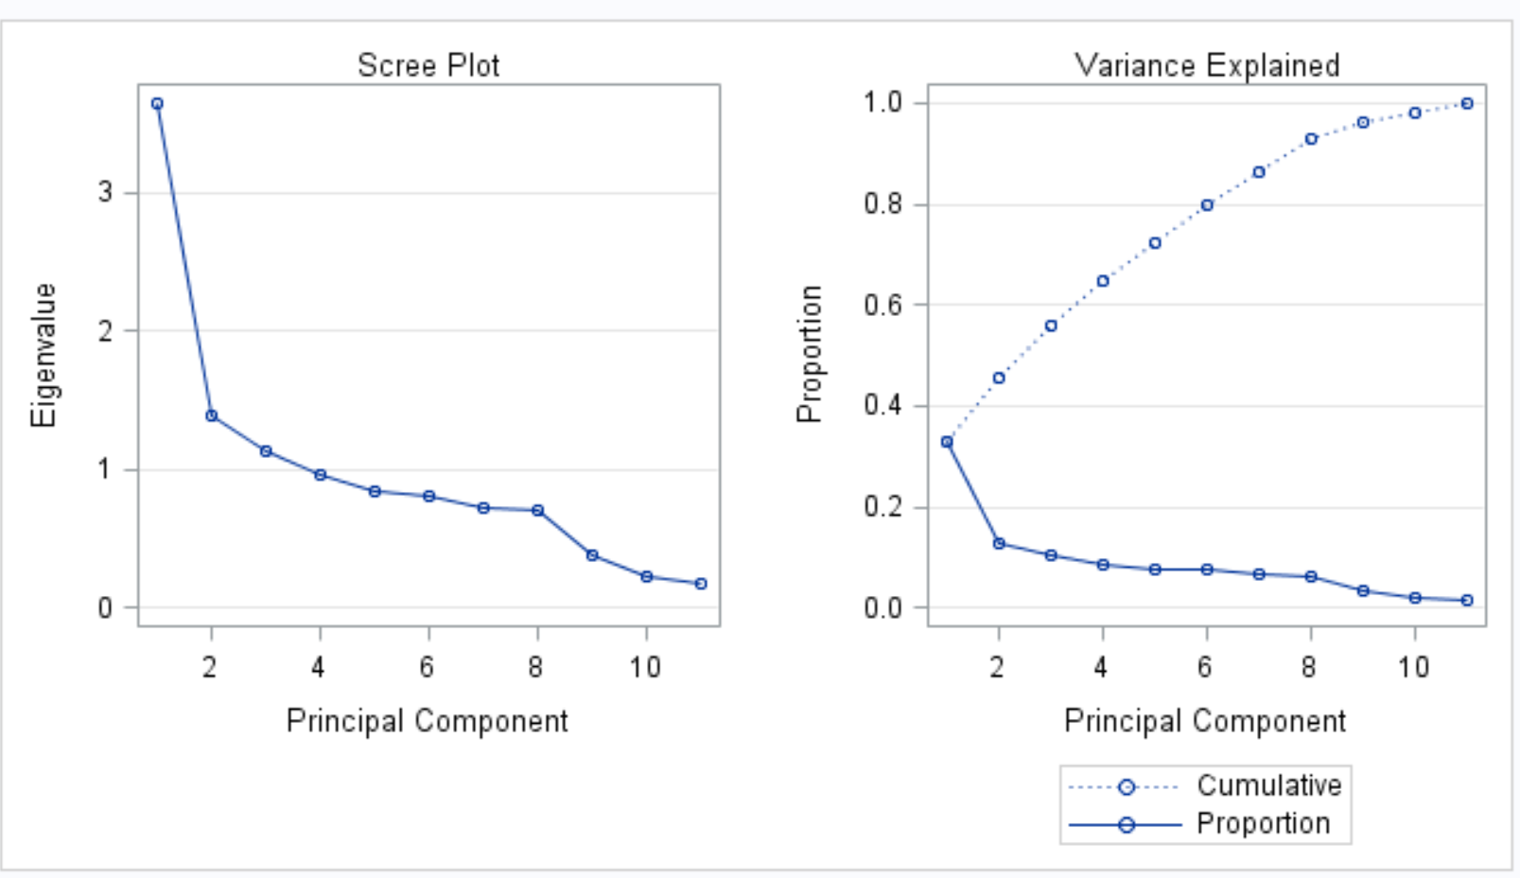
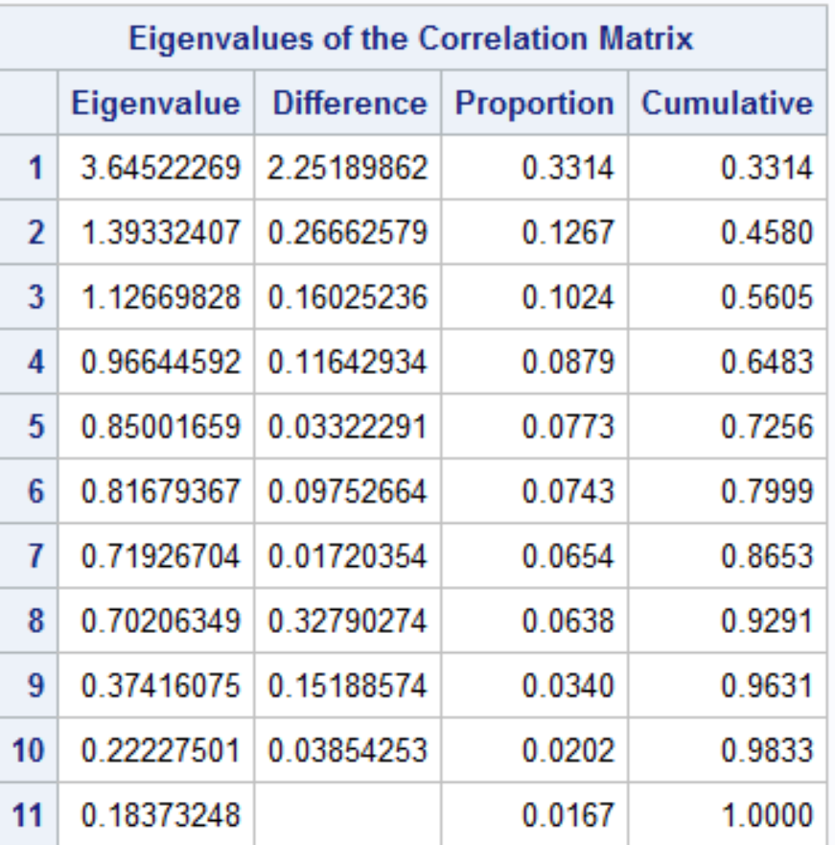
PCA
Eigen Values :
Taking 4 Components for Analysis which explains around 65 percent of variance. (prin1 prin2 prin3 prin3).

Slide 26
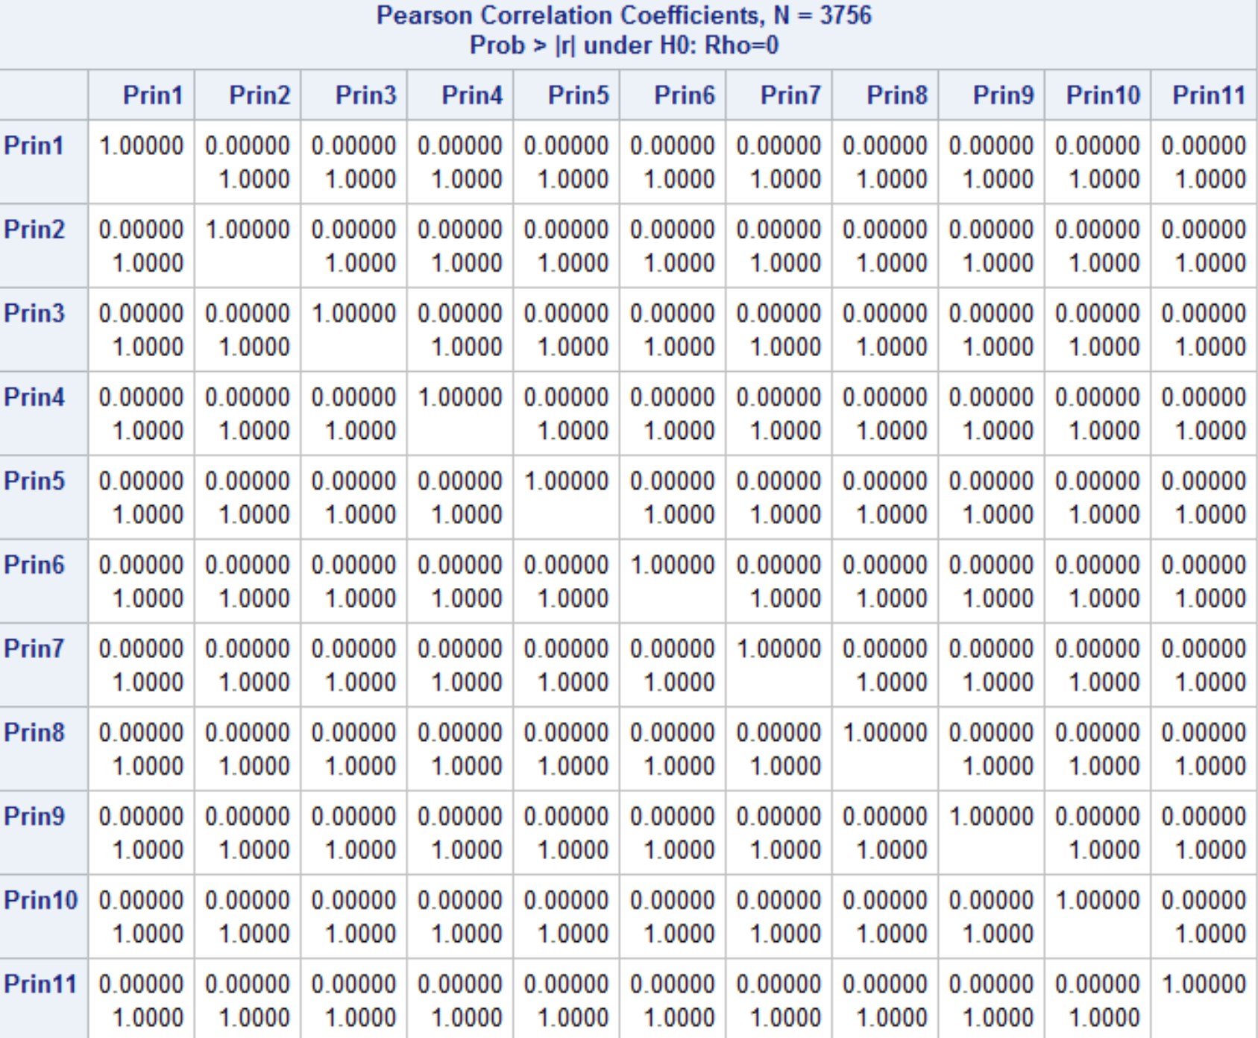
PCA

Slide 27
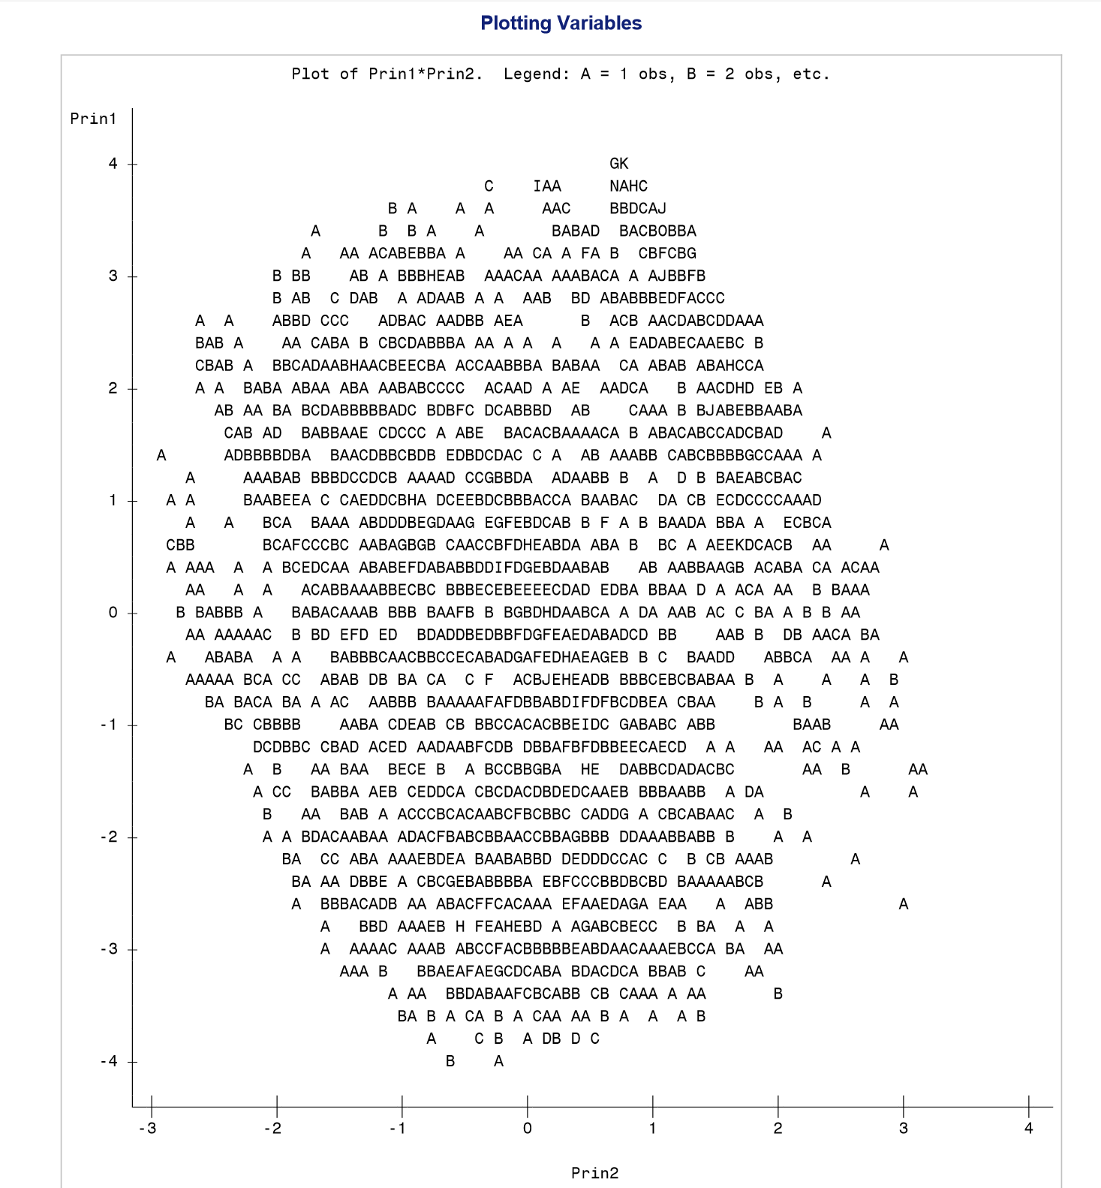
PCA
Applied PCA using those Four Components
Plotting Prin1*Prin2
Testing the Model using the Four
Components
Divide the data as ODD and EVEN
Using Score, applied the model over the
Test data

Slide 28
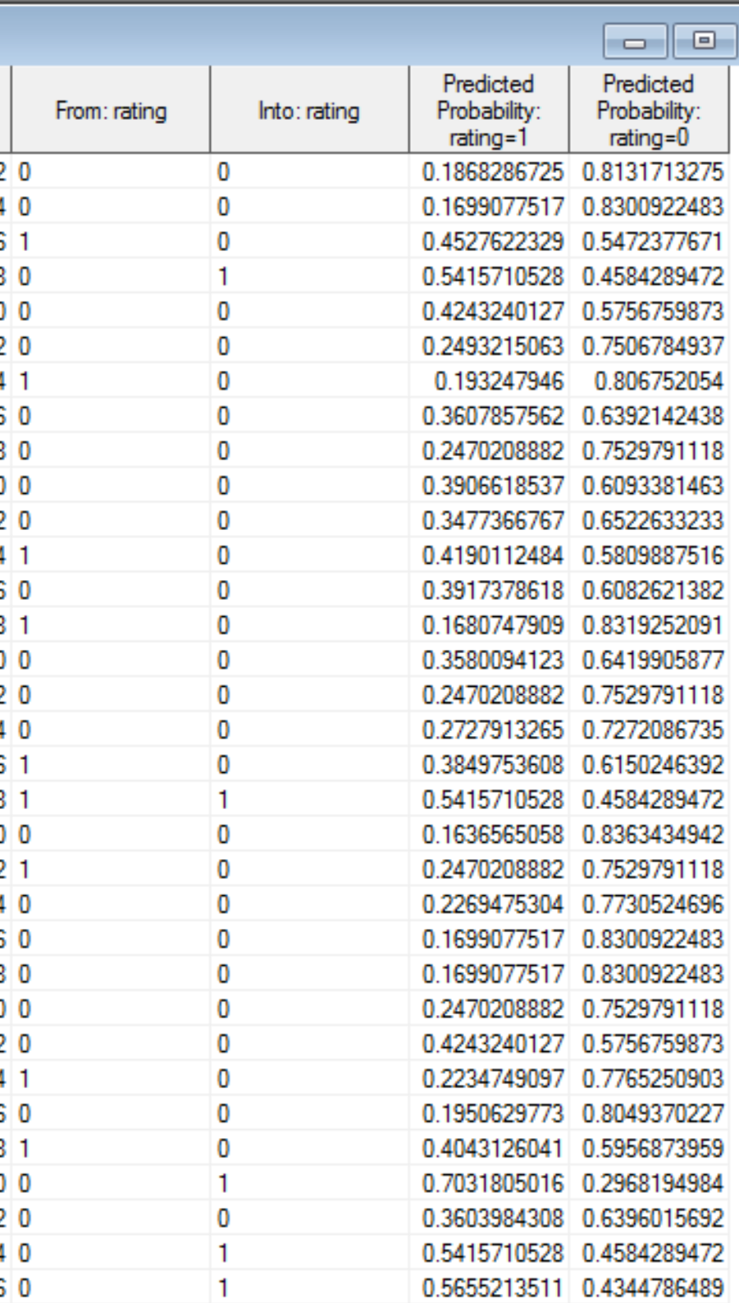
Final Predicted Output

Slide 29
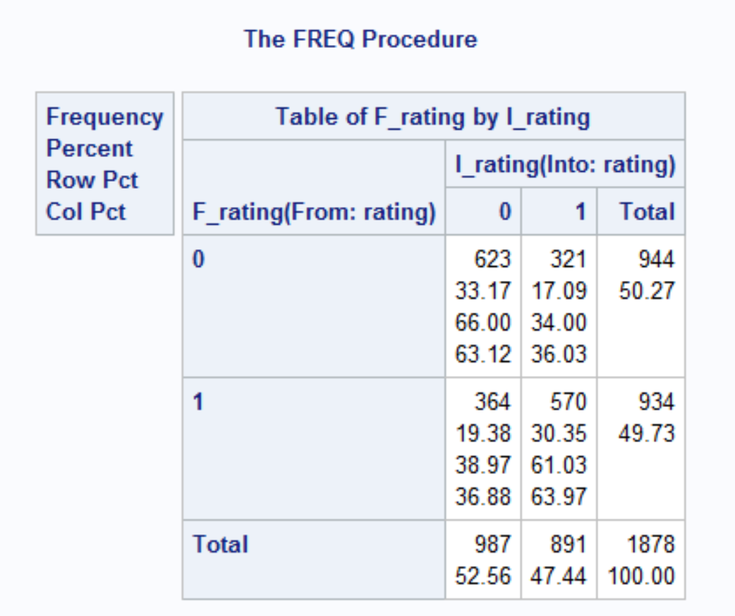
Actual vs Predicted

Slide 30
Conclusion
Finally we conclude that the model we built predicted correctly around 70 percent of the test data by using the variables we have considered.
We can use this predictive model on any new dataset having the same variables for optimal solution.

Slide 31
Future Scope
There can be many ways of representing the data:
We can work more on the accuracy rate of the model.
We can predict movie ratings even deeper based on other factors, example: History of production house having it as a categorical factor.

Slide 32
References
https://www.kaggle.com/deepmatrix/imdb-5000-movie-dataset
http://www.imdb.com/
https://www.youtube.com/watch?v=8WIpTj2XFDQ
https://www.youtube.com/watch?v=s2pv7RMsjjM
Class Notes

Slide 33
Thank you

